Slide 1
Team Gradient Descent
Chris, Tony, Bracken

Slide 2
What Challenges Do Freshmen Face?

Slide 3
What Can Solve These Issues?

Slide 4
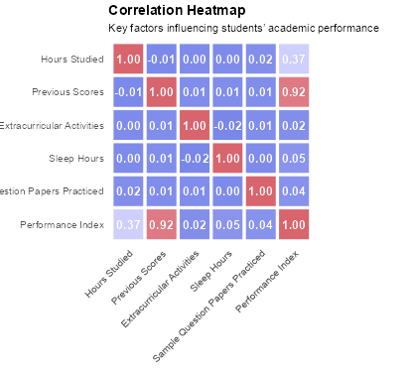
Correlation between Academic Performance and Study Habits
A recent study found prior academic achievement (correlation ~ 0.92) and hours studied (~0.37) strongly relate to student performance.
“Quality Over Quantity … Effective study techniques, such as active learning, spaced repetition, …, were found to enhance the benefits of study hours.”
SpringerOpen

Slide 5
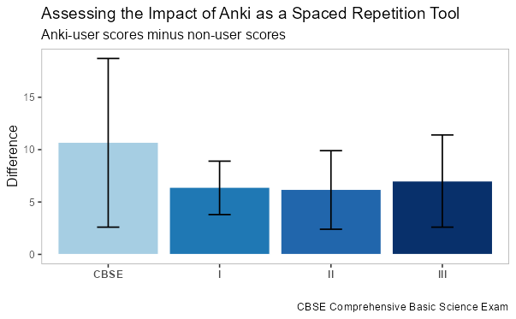
Studying with Anki (Study Link)
Anki uses a spaced repetition methodology to increase retention and recall.
The graph shows that those who studied with Anki outperformed on every test within their courses and during a standardized test.
PubMed

Slide 6
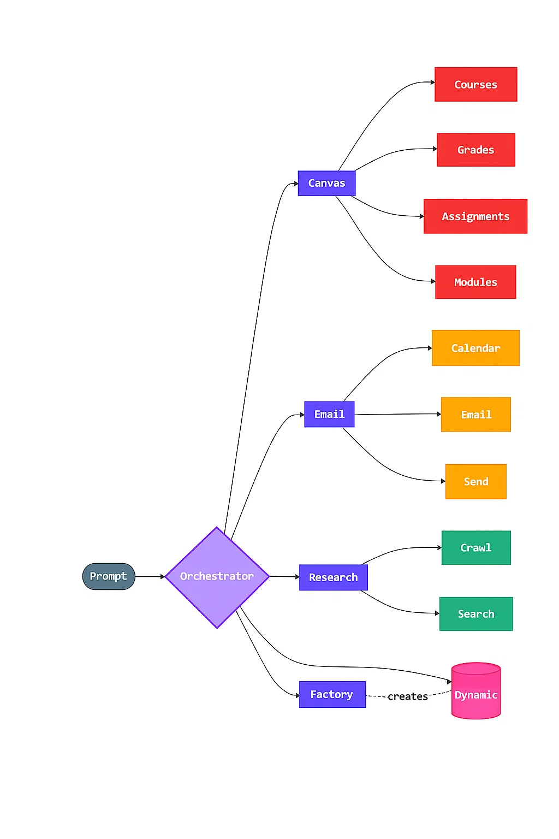
Our Solution — The Agentic Study Assistant
Includes three specialized agents:
  Researcher Agent
  Email Agent
  Canvas Agent

Slide 7
Demonstration

Slide 8
Thoughts for the Future

